Slide 1
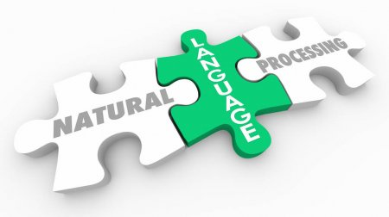
Reverse Mad Libs
Natural Language Processing
Scott Bing

Slide 2
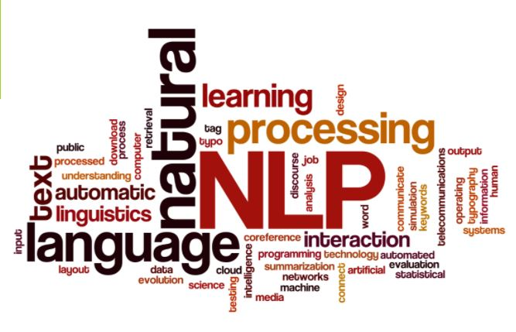
Reverse Mad Libs
Natural Language Processing
Scott Bing

Slide 3
Agenda
Introduction
What is Natural Language Processing
A Brief History of NLP
My Project: Reverse Mad Libs Game
Resources used
Questions

Slide 4
Natural Language Processing
An attempt to meld human language with computer language.
Teach a computer how to converse with a human

Slide 5

Not this Bert

Slide 6
Bert
Sentence Classification
Train a Classifier

Slide 7
What is BERT?

